Slide 1
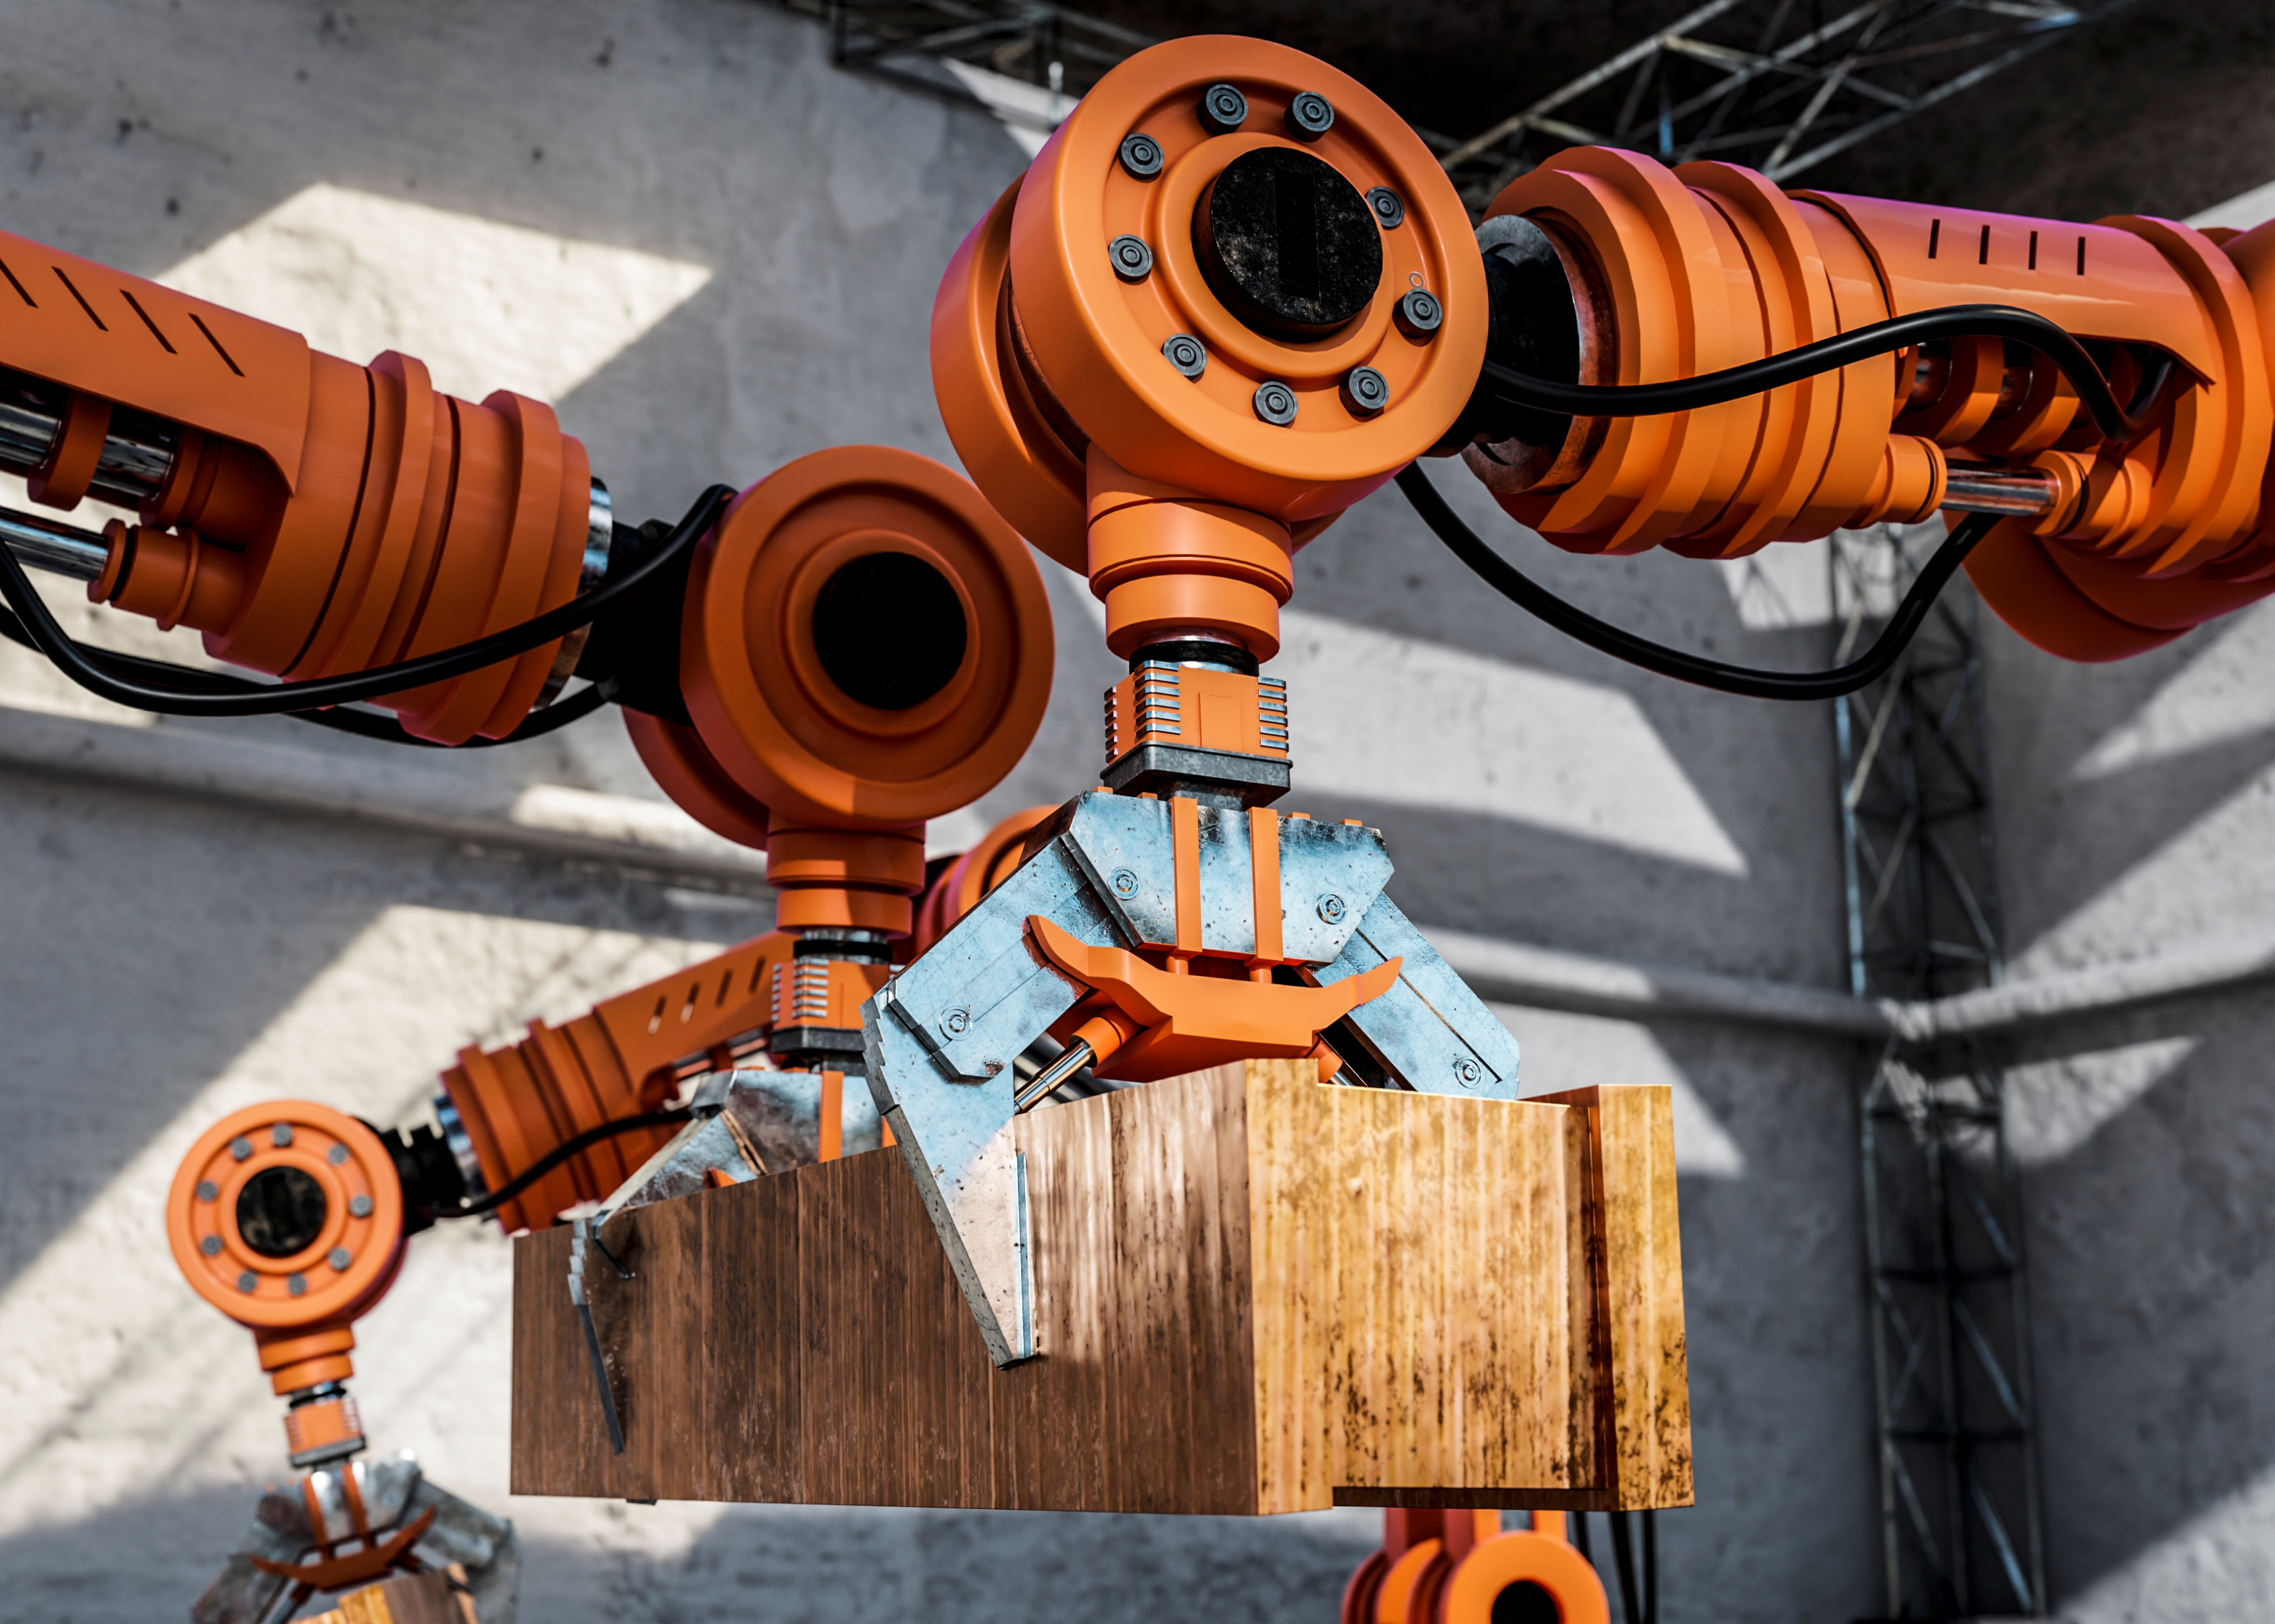



Slide 2


Slide 3
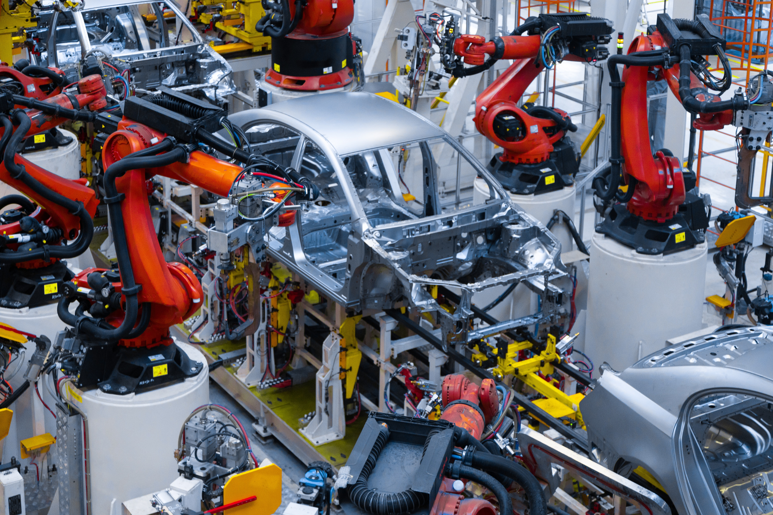
FIRST LEAGUE
IN AUTOMATION

Slide 4
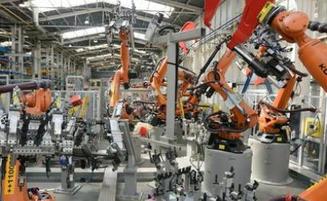
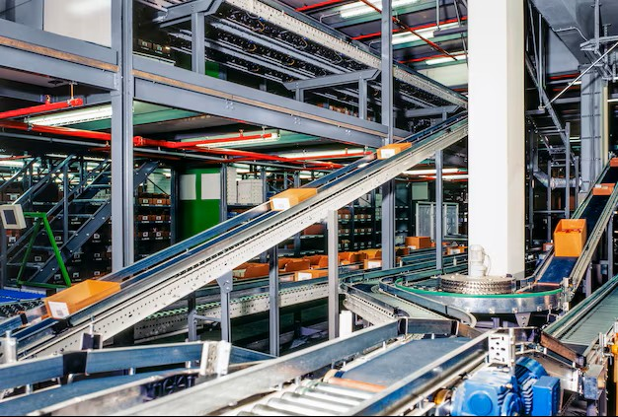
EHM INDUSTRIAL SERVICES:
We are building the future of industry

Slide 5
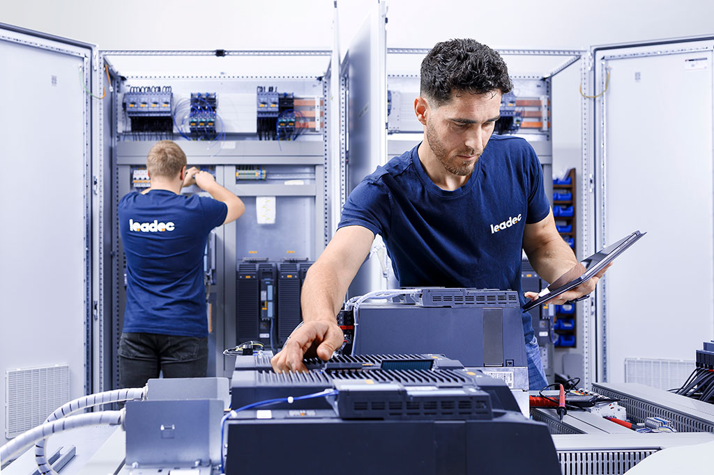
EHM INDUSTRIAL SERVICES:
We are building the future of industry
A global partner for intelligent automation and automotive excellence

Slide 6
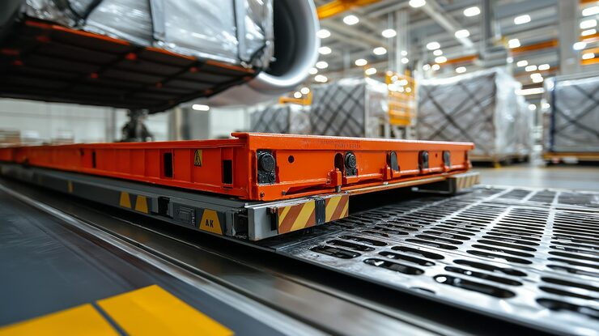
EHM INDUSTRIAL SERVICES:
We are building the future of industry
EMH INDUSTRIAL SERVICES s.r.o. (Europe)
EMH INDUSTRIAL SERVICES LLC (USA)
A global partner for intelligent automation and automotive excellence
EMH INDUSTRIAL SERVICES Co.Ltd (China)

Slide 7
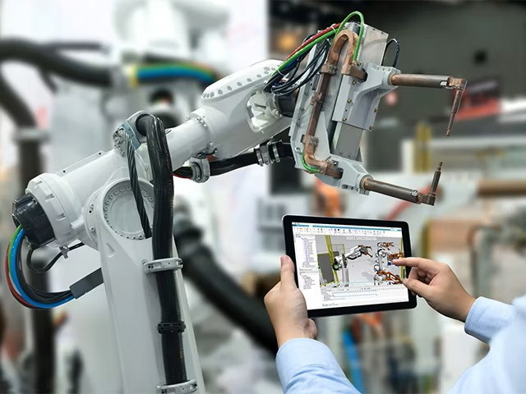
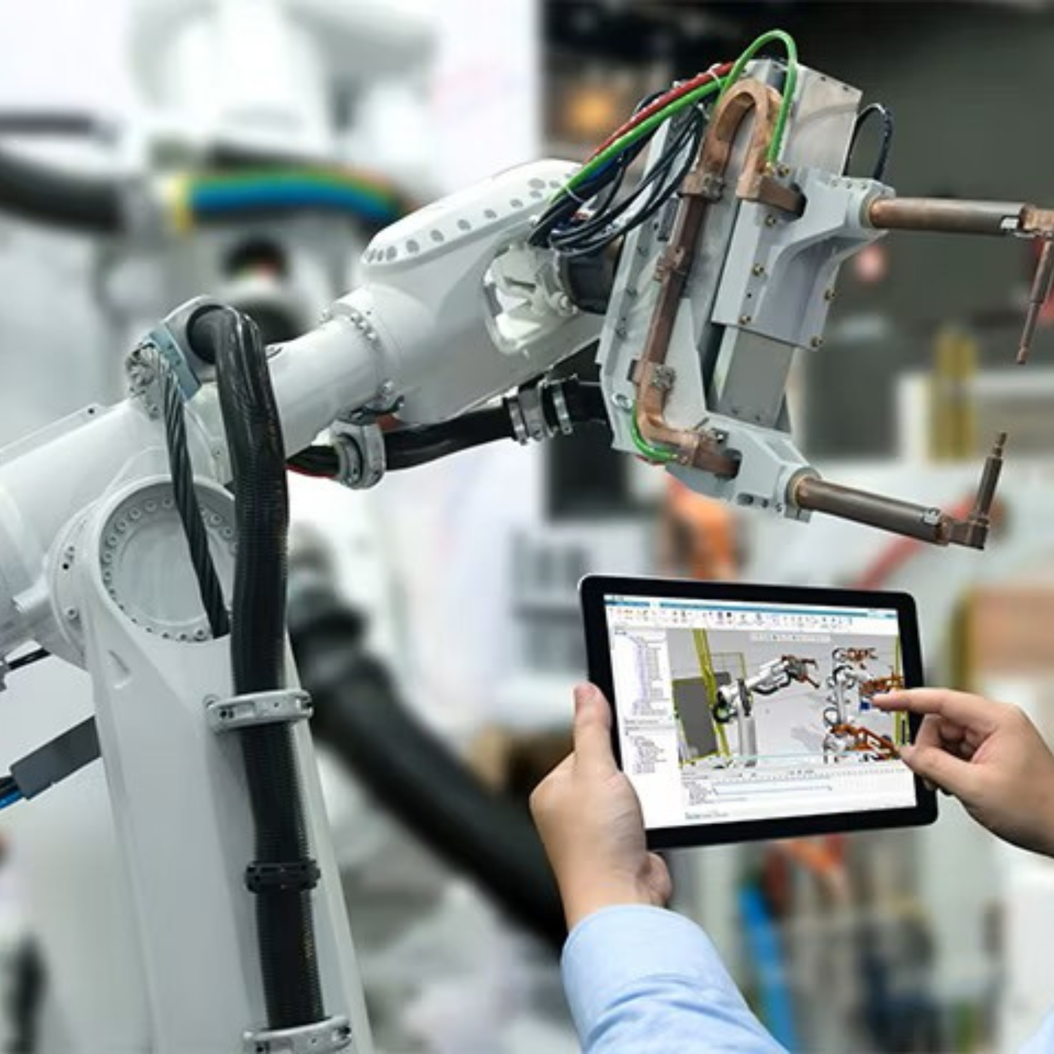
EHM INDUSTRIAL SERVICES:
We are building the future of industry
In today’s dynamic times, automation is the key to sustainability and efficiency
Our key message: AUTOMATION
Automation: More than just technology – we make life easier
A global partner for intelligent automation and automotive excellence

Slide 8
EHM INDUSTRIAL SERVICES:
We are building the future of industry
We transform complex processes into intelligent systems that save time, increase safety and unlock human potential for more creative work.
Our key message: AUTOMATION
We build systems that transform the way the world produces.
A global partner for intelligent automation and automotive excellence

Slide 9

WE ARE WHERE YOUR BUSINESS IS
GLOBAL PRESENCE
GLOBAL REACH
LOCAL EXPERTISE

Slide 10

OUR STRATEGIC OFFICES ACROSS THREE CONTINENTS ENSURE RAPID RESPONSE AND DEEP KNOWLEDGE OF LOCAL MARKETS:

Slide 11

EUROPE: NITRA, SLOVAKIA
HEADQUARTERS AND
TECHNICAL INFRASTRUCTURE

Slide 12

USA: Jacksonville, Florida

Slide 13

China: Hong Kong

Slide 14
PROJECT MANAGEMENT
Professional management
from the first sketch
to final delivery.
COMMISSIONING
Restoring production lines
and robots, PLC programming
and final optimization for maximum performance.
MECHANICAL ENGINEERING
Construction of advanced conveyor systems and
installation of robotic arms.
ELECTRICAL EXCELLENCE
FROM CONCEPT TO REALITY:
FULL-SERVICE SOLUTIONS
Complete electrical
installation of automated
systems and switchboards.
PROJECT MANAGEMENT and
TECHNICAL SUPERVISION
INDUSTRIAL SERVICES
and MAINTENANCE

Slide 15
PROJECT MANAGEMENT
COMMISSIONING
Restoring production lines
and robots, PLC programming
and final optimization for maximum performance.
Professional management
from the first sketch
to final delivery.
MECHANICAL ENGINEERING
ELECTRICAL EXCELLENCE
Construction of advanced conveyor systems and
installation of robotic arms.
Complete electrical
installation of automated
systems and switchboards.
A COMPREHENSIVE PORTFOLIO OF SERVICES
PROJECT MANAGEMENT and
TECHNICAL SUPERVISION
INDUSTRIAL SERVICES
and MAINTENANCE

Slide 16
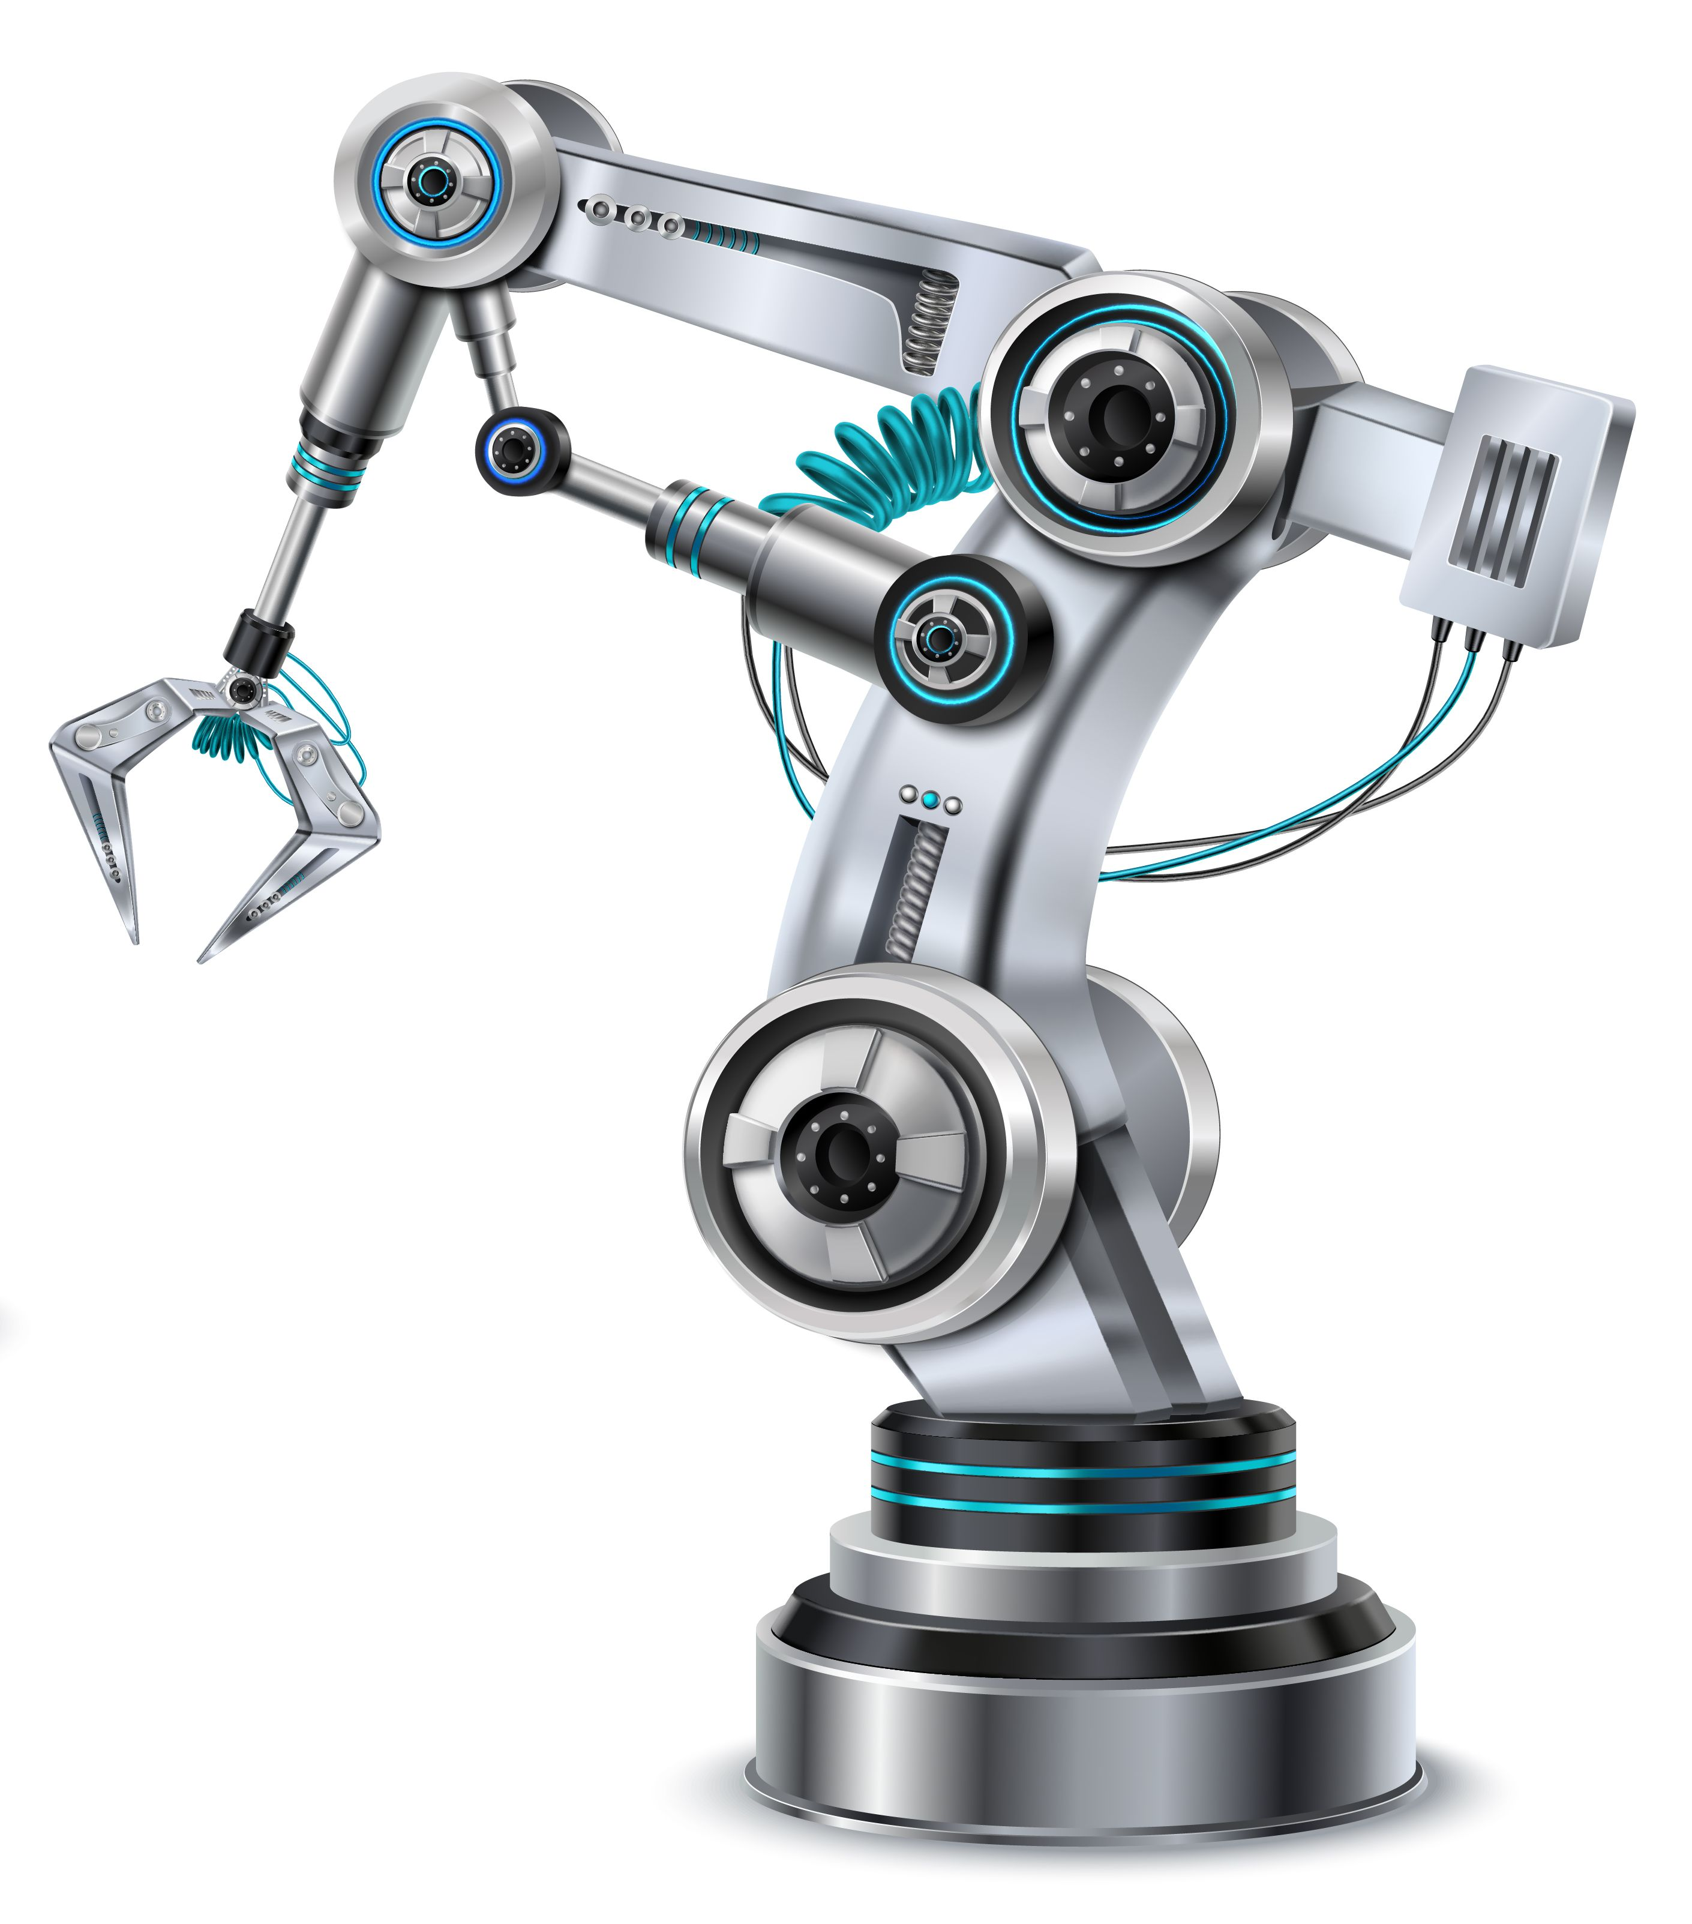
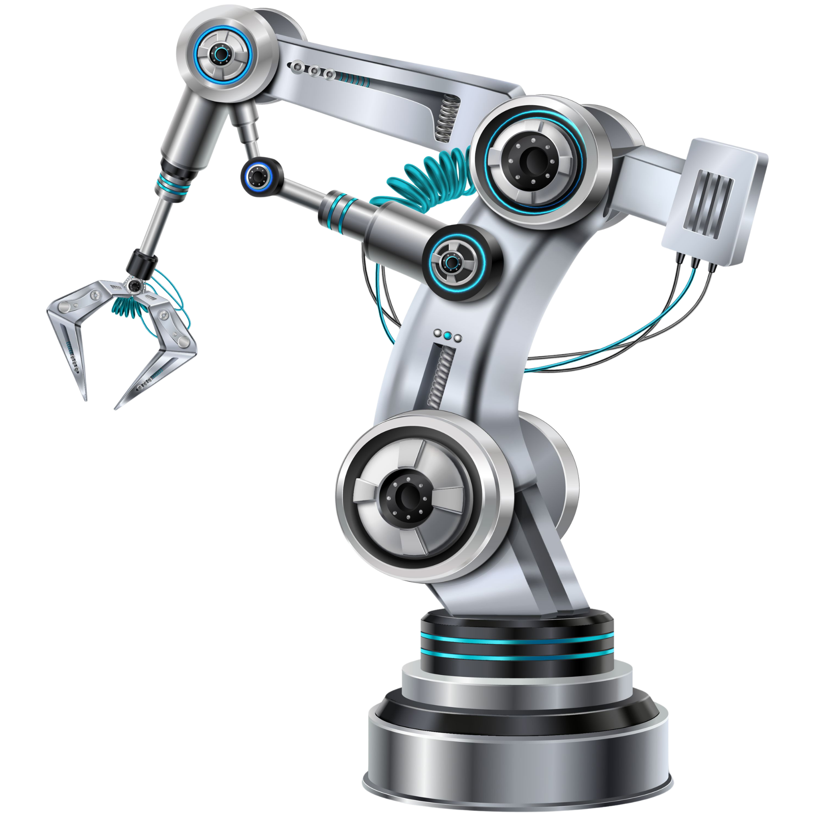

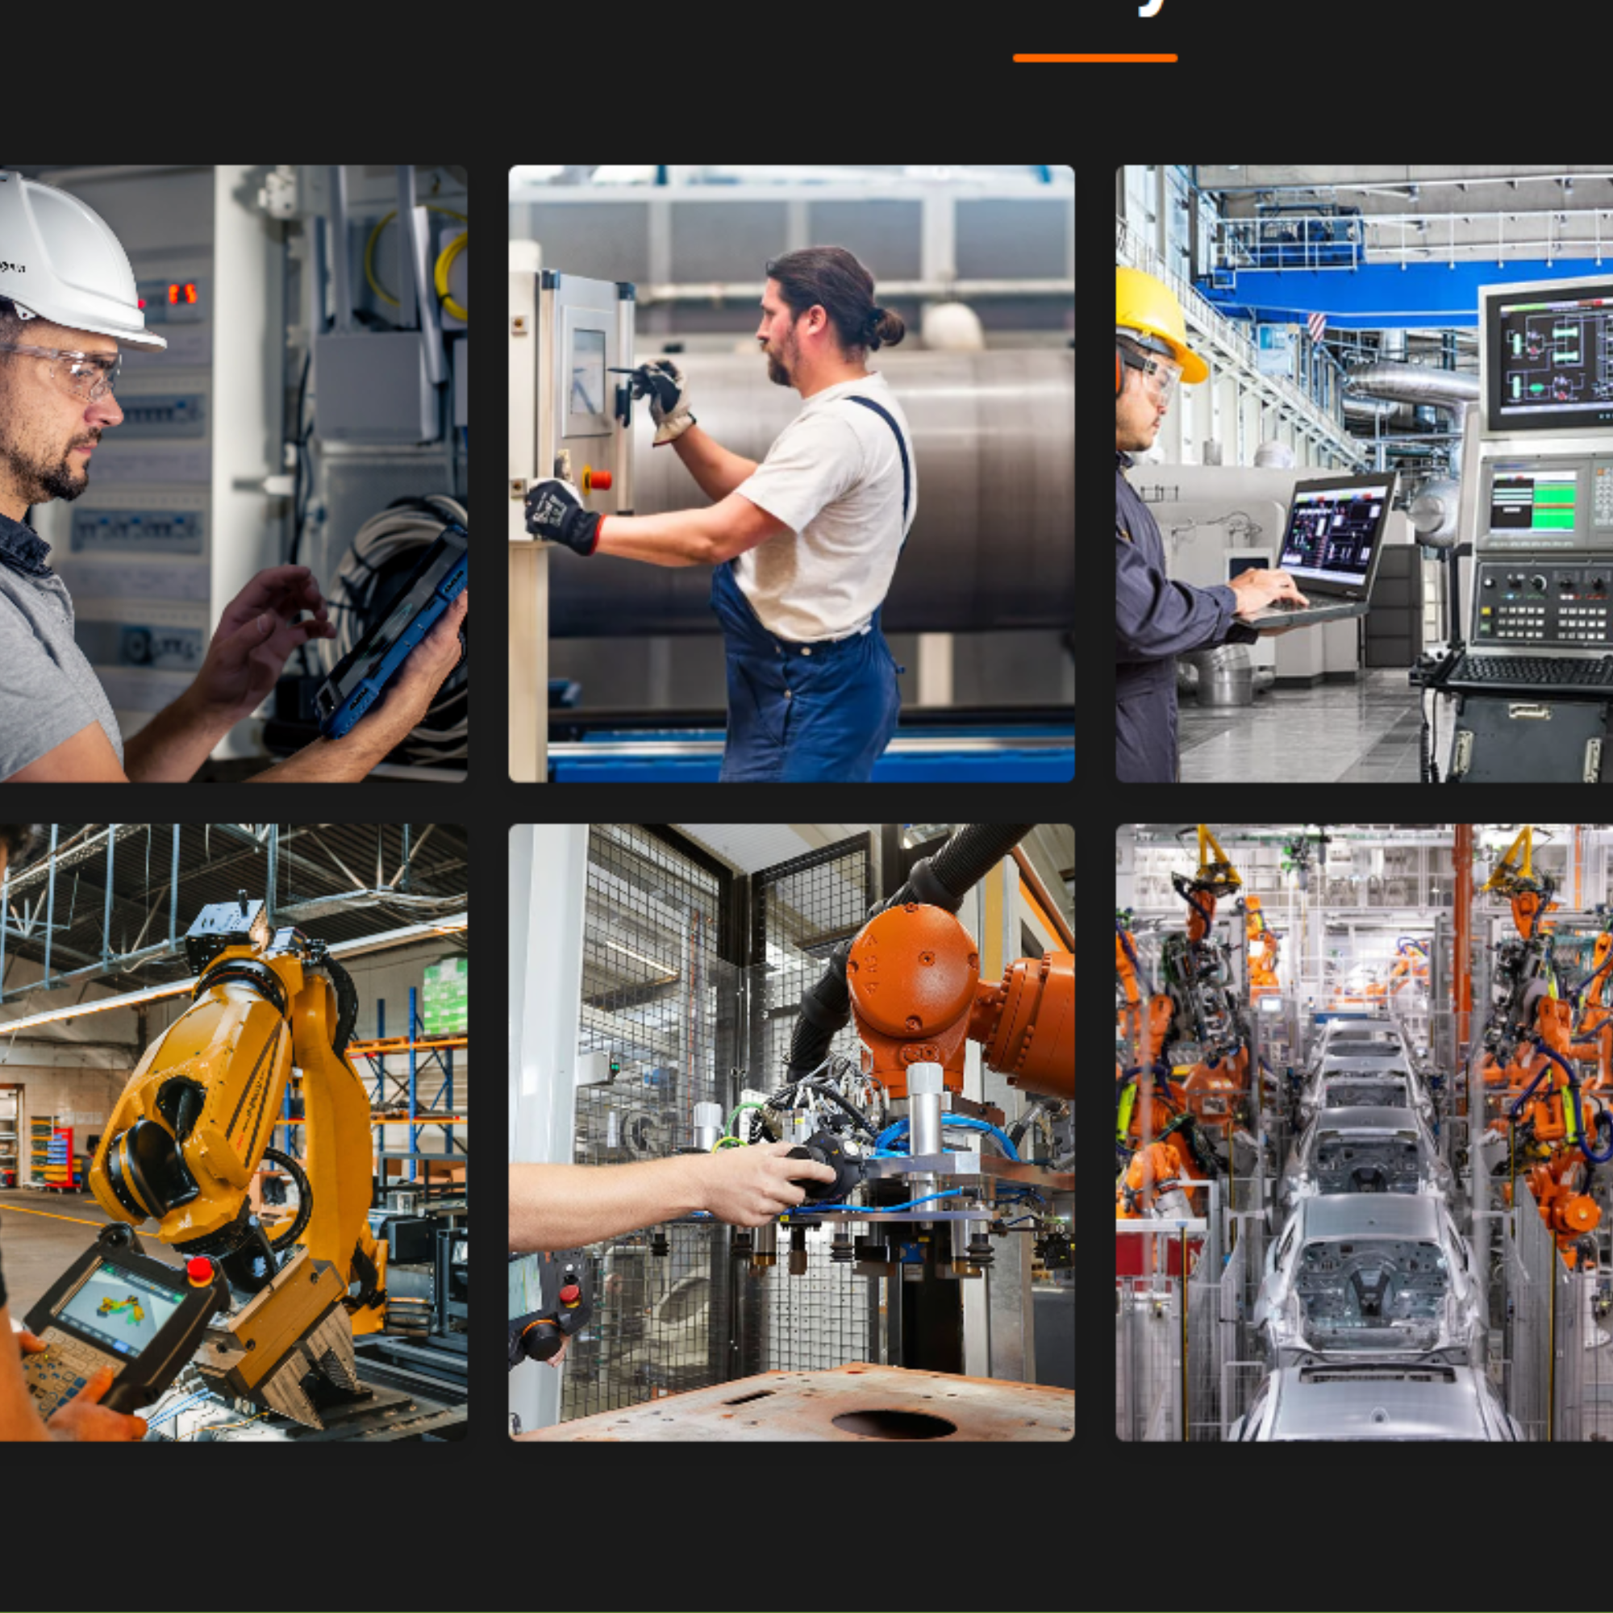

COMMISSIONING
Restoring production lines
and robots, PLC programming
and final optimization for maximum performance.
PROJECT MANAGEMENT
Professional management
from the first sketch
to final delivery.
PEOPLE-DRIVEN QUALITY:
MECHANICAL ENGINEERING
Our DNA: Quality and top-notch professionals
ELECTRICAL EXCELLENCE
Construction of advanced conveyor systems and
installation of robotic arms.
Complete electrical
installation of automated
systems and switchboards.
Uncompromising quality: Every detail of our system adheres to strict technical standards
PROJECT MANAGEMENT and
TECHNICAL SUPERVISION
INDUSTRIAL SERVICES
and MAINTENANCE

Slide 17
PEOPLE-DRIVEN QUALITY:
Our DNA: Quality and top-notch professionals
COMMISSIONING
Restoring production lines
and robots, PLC programming
and final optimization for maximum performance.
Uncompromising quality: Every detail of our system adheres to strict technical standards
PROJECT MANAGEMENT
Professional management
from the first sketch
to final delivery.
ELITE TEAM OF SPECIALISTS:
We provide specialists in assembly, electrical installation and robotics across key manufacturing sectors, experienced in international environments and focused on precision and quality.
MECHANICAL ENGINEERING
ELECTRICAL EXCELLENCE
Construction of advanced conveyor systems and
installation of robotic arms.
Complete electrical
installation of automated
systems and switchboards.
GOOD WORK IS NOT THE GOAL, BUT OUR STARTING POINT AND A GIVEN.
PROJECT MANAGEMENT and
TECHNICAL SUPERVISION
INDUSTRIAL SERVICES
and MAINTENANCE

Slide 18
PEOPLE-DRIVEN QUALITY:
Our DNA: Quality and top-notch professionals
COMMISSIONING
Restoring production lines
and robots, PLC programming
and final optimization for maximum performance.
Uncompromising quality: Every detail of our system adheres to strict technical standards
PROJECT MANAGEMENT
Professional management
from the first sketch
to final delivery.
AUTOMOTIVE:
OUR CORE DOMAIN
MECHANICAL ENGINEERING
ELECTRICAL EXCELLENCE
Construction of advanced conveyor systems and
installation of robotic arms.
Complete electrical
installation of automated
systems and switchboards.
WE ARE TRUSTED BY THE WORLD’S BIGGEST NAMES.
PROJECT MANAGEMENT and
TECHNICAL SUPERVISION
INDUSTRIAL SERVICES
and MAINTENANCE
GOOD WORK IS NOT THE GOAL, BUT OUR STARTING POINT AND A GIVEN.

Slide 19


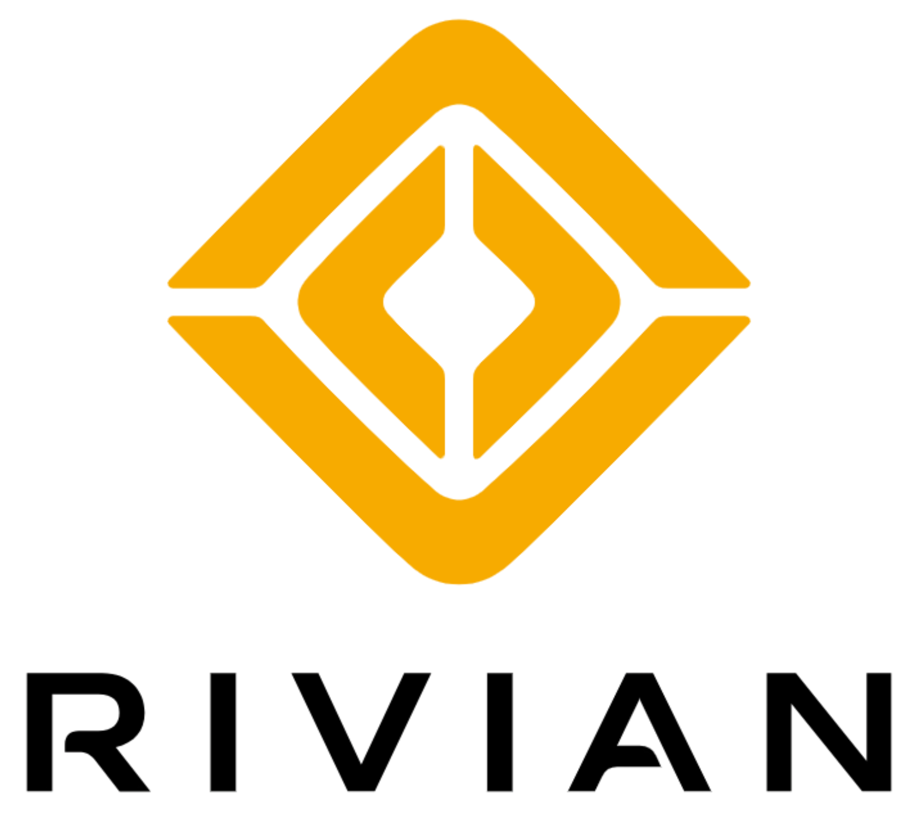



PEOPLE-DRIVEN QUALITY:
Our DNA: Quality and top-notch professionals
COMMISSIONING
Restoring production lines
and robots, PLC programming
and final optimization for maximum performance.
Uncompromising quality: Every detail of our system adheres to strict technical standards
PROJECT MANAGEMENT
Professional management
from the first sketch
to final delivery.
OUR REFERENCE PROJECTS:
MECHANICAL ENGINEERING
ELECTRICAL EXCELLENCE
Construction of advanced conveyor systems and
installation of robotic arms.
Complete electrical
installation of automated
systems and switchboards.
USA: Tesla (Nevada & Texas) Rivian (Illinois)
Europe: Volvo (Gothenburg & Košice), Volkswagen (Bratislava & Poznaň), Ford (Turkey)
Asia: Projects for First Solar in India
PROJECT MANAGEMENT and
TECHNICAL SUPERVISION
INDUSTRIAL SERVICES
and MAINTENANCE
GOOD WORK IS NOT THE GOAL, BUT OUR STARTING POINT AND A GIVEN.

Slide 20
PEOPLE-DRIVEN QUALITY:
Our DNA: Quality and top-notch professionals
COMMISSIONING
Restoring production lines
and robots, PLC programming
and final optimization for maximum performance.
Uncompromising quality: Every detail of our system adheres to strict technical standards
PROJECT MANAGEMENT
Professional management
from the first sketch
to final delivery.
EXPANSION BEYOND AUTOMOTIVE:
MECHANICAL ENGINEERING
ELECTRICAL EXCELLENCE
Construction of advanced conveyor systems and
installation of robotic arms.
Complete electrical
installation of automated
systems and switchboards.
Scalable solutions for every industry
We are experts in the automotive industry and our systems also bring efficiency in the renewable energy sector
First Solar: Successful implementation of automation in solar panel manufacturing (India; USA - Perrysburg, Louisiana, Alabama)
PROJECT MANAGEMENT and
TECHNICAL SUPERVISION
INDUSTRIAL SERVICES
and MAINTENANCE
GOOD WORK IS NOT THE GOAL, BUT OUR STARTING POINT AND A GIVEN.

Slide 21
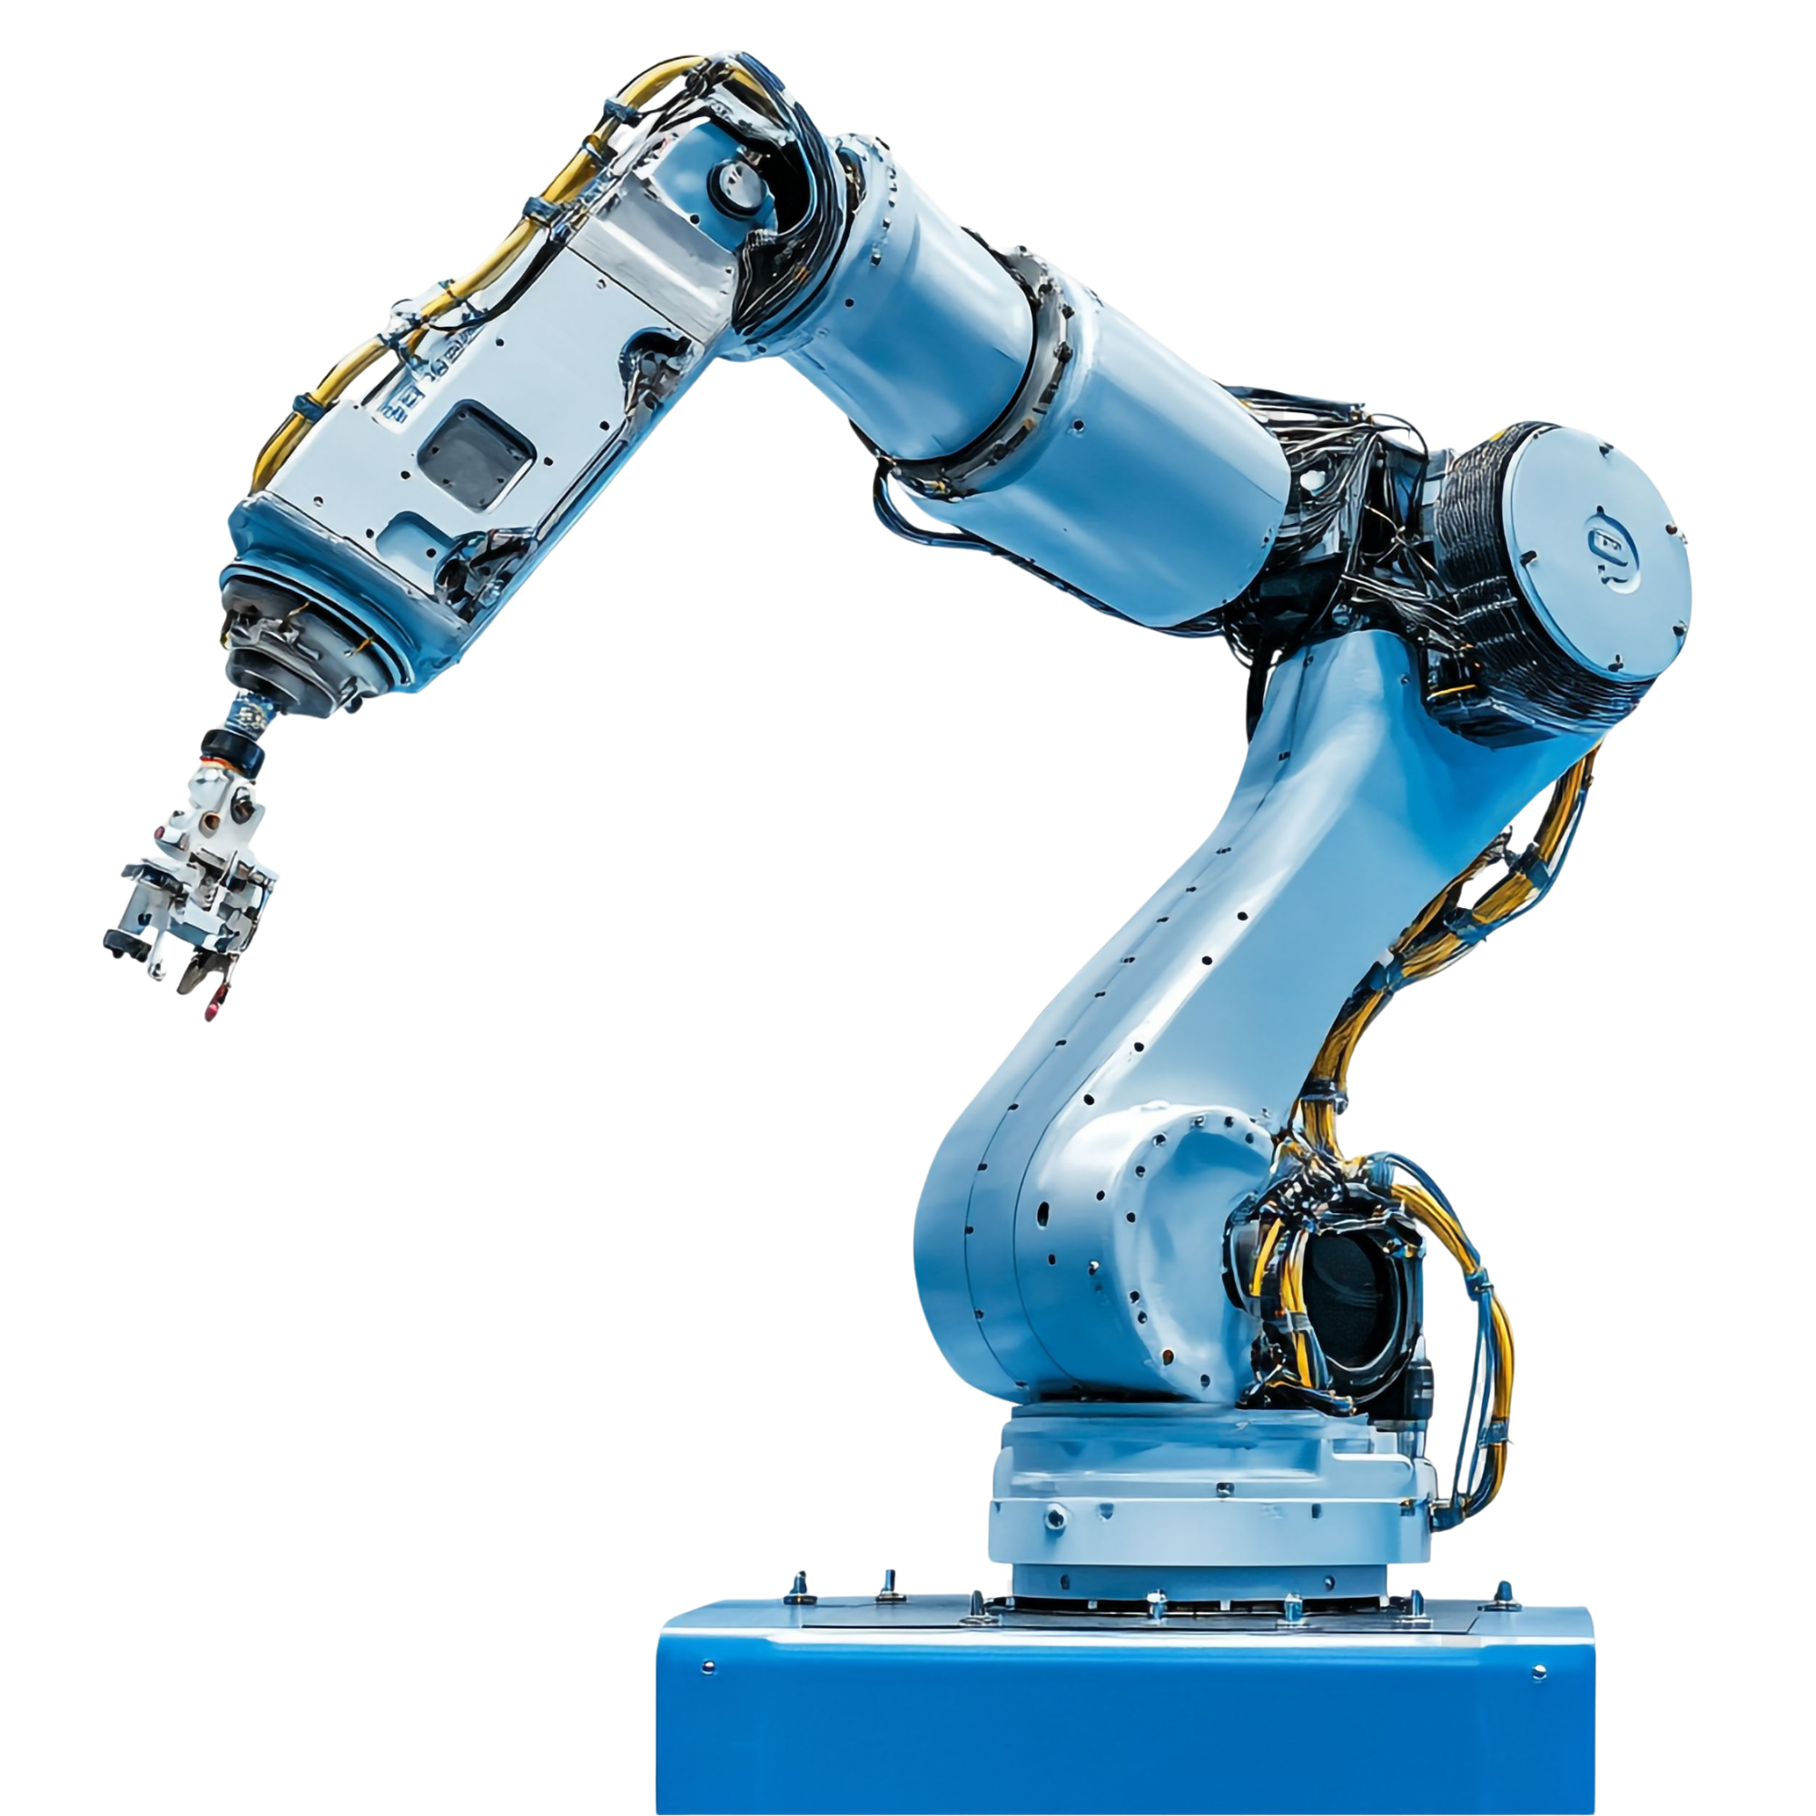
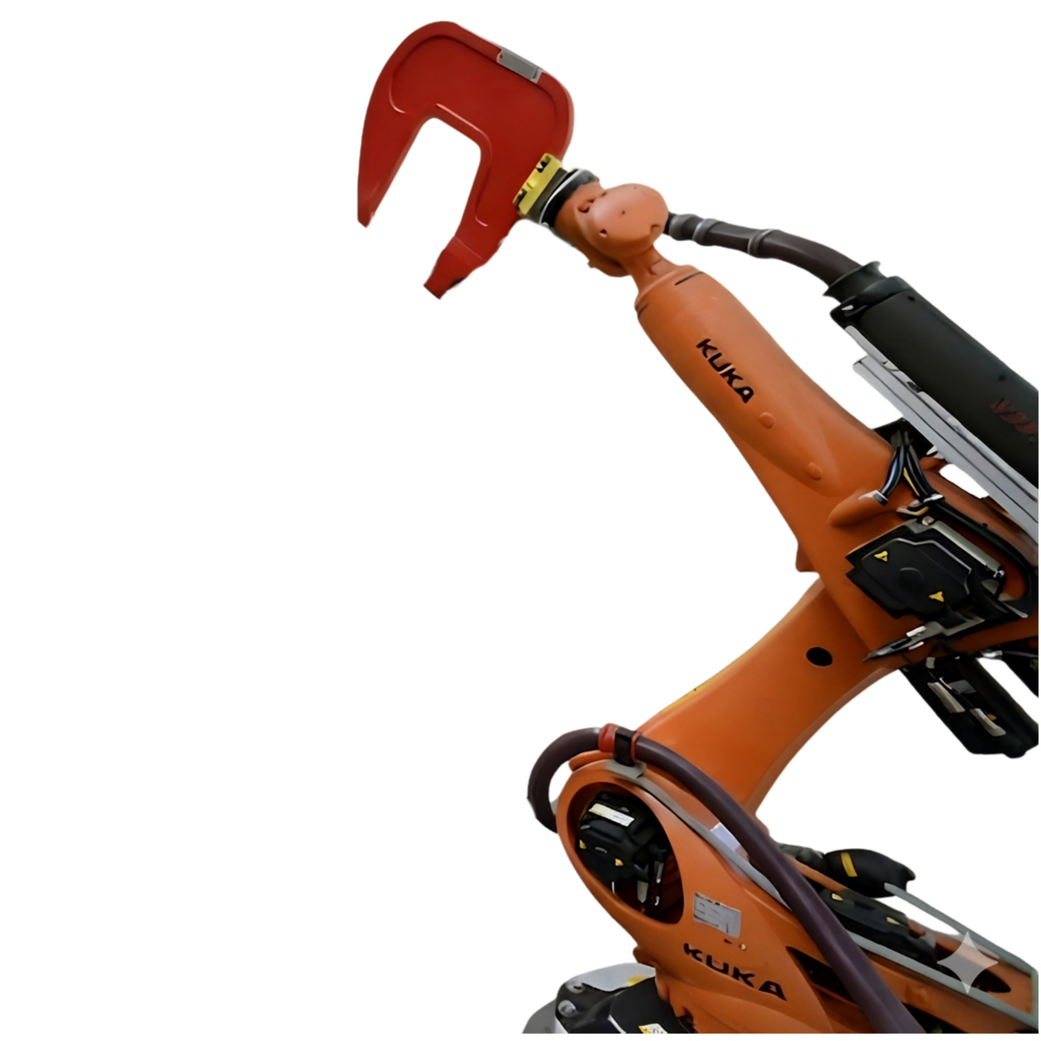
EXPANSION BEYOND AUTOMOTIVE:
PEOPLE-DRIVEN QUALITY:
Our DNA: Quality and top-notch professionals
COMMISSIONING
Restoring production lines
and robots, PLC programming
and final optimization for maximum performance.
Uncompromising quality: Every detail of our system adheres to strict technical standards
PROJECT MANAGEMENT
Professional management
from the first sketch
to final delivery.
MECHANICAL ENGINEERING
ELECTRICAL EXCELLENCE
Construction of advanced conveyor systems and
installation of robotic arms.
Complete electrical
installation of automated
systems and switchboards.
„OUR SUCCESSFULLY DELIVERED PROJECTS ARE OUR BEST REFERENCE“
PROJECT MANAGEMENT and
TECHNICAL SUPERVISION
INDUSTRIAL SERVICES
and MAINTENANCE
GOOD WORK IS NOT THE GOAL, BUT OUR STARTING POINT AND A GIVEN.

Slide 22




GLOBAL INFRASTUCTURE
EU, USA, China
YOUR PARTNER FOR GROWTH
MAKING LIFE EASIER
through innovative
automation
PROVEN EXPERIENCE
IN THE MOST
DEMANDING PROJECTS
Tesla, VW, Volvo
HIGHLY QUALIFIED TEAMS
ready for global deployment

Slide 23
GLOBAL INFRASTUCTURE
EU, USA, China
MAKING LIFE EASIER
through innovative
automation
PROVEN EXPERIENCE
IN THE MOST
DEMANDING PROJECTS
Tesla, VW, Volvo
HIGHLY QUALIFIED TEAMS
ready for global deployment

Slide 24
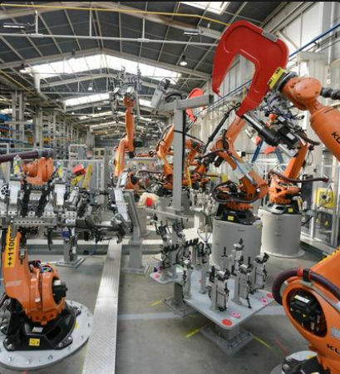
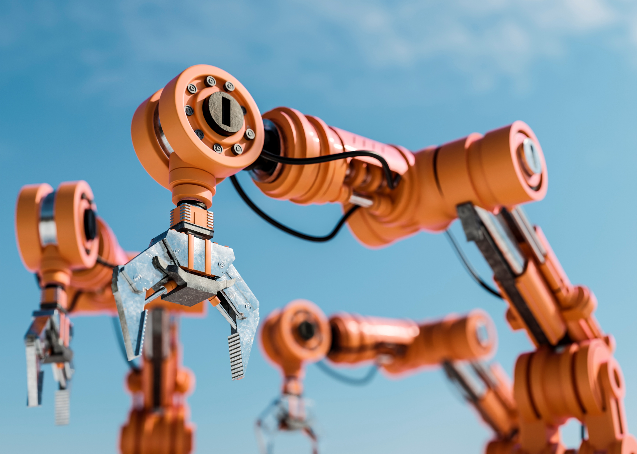

LET'S BUILD A BETTER WORLD
LET'S BUILD A BETTER WORLD
Farská 1342/50, Nitra, Slovakia
E-mail: info@emhindustrialservices.eu
www.emhindustrialservices.eu
We look forward to building
your future successes together.

